Slide 1

Not Left. Not Right. Forward
Forward Party of Utah

Slide 2

Our Values
Rule of law, respect for the Constitution
Support and strengthen Democracy to restore the voters’ voice
American leadership
Build from the bottom up, not the top down
Use data to drive collaborative and effective solutions, regardless of their ideological source
Innovation and entrepreneurship are central to American culture and our future
Individual liberty, personal responsibility, and civic engagement
Treat everyone with respect and dignity
Act with ethics, integrity, and compassion

Slide 3
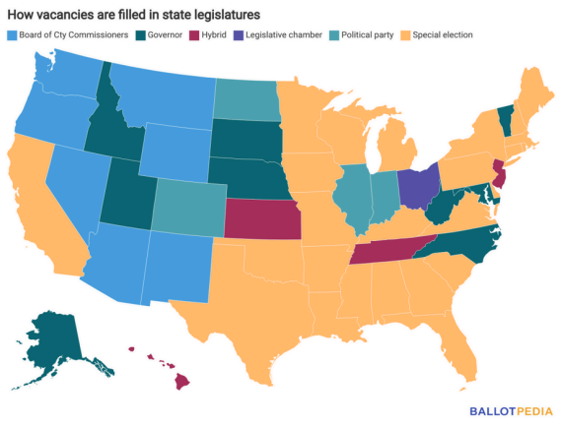
Filling vacancies in the state legislature
Instead of having a special election, the Governor fills vacancies in the state legislature
The Governor appoints a replacement, but party leadership/delegates select the replacement

Slide 4
Our Values in Action
About one third of current (10 of 29) Utah State Senators were appointed
In 2024, the incumbent reelection rate in the Utah State Legislature was 99%
In March 2025, State Sen. Daniel Thatcher (SD11) left the Republican Party to join the Forward Party
In October 2025, State Sen. Daniel Thatcher (SD11) announced he would be resigning
Instead of Forward Party leadership choosing a replacement, a special secure online approval vote was held for all the residents of SD11, regardless of party affiliation (first state legislature level use of approval voting)
In December 2025, after winning the approval vote, Sen. Emily Buss took office
The state legislature is trying to prevent this from ever happening again (SB194)

Slide 5
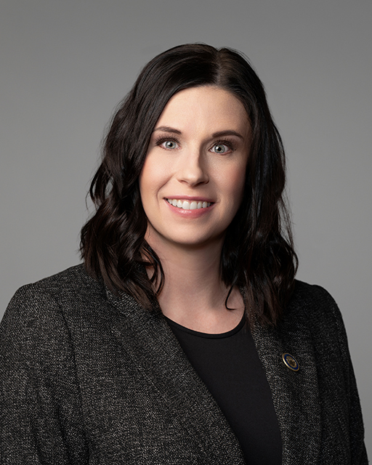
Getting to work
Sen. Emily Buss sponsored SB 189
  Creates High Growth District Grant program
  Seeks to alleviate the burden on high-growth districts struggling with infrastructure needs due to fast-paced residential development.
SB 189 has passed Senate Education Committee with a favorable recommendation

Slide 6
Current Top Priorities
Election Process Reform: Make the election process more inclusive
Representative Voting Districts: Eliminate partisan gerrymandering
Representative Voting Methods: Eliminate the need to vote for the “lesser of two evils”
Campaign Finance Reform: Limit corporate and organizational donations to political campaigns
Government Transparency: Ethics reforms
Limit partisan influence: More non-partisan local and county races
Separation of Powers: Strong, independent branches of government
Government Accountability: Allow citizens to recall elected officials
Housing Availability: Increase availability and affordability

Slide 7
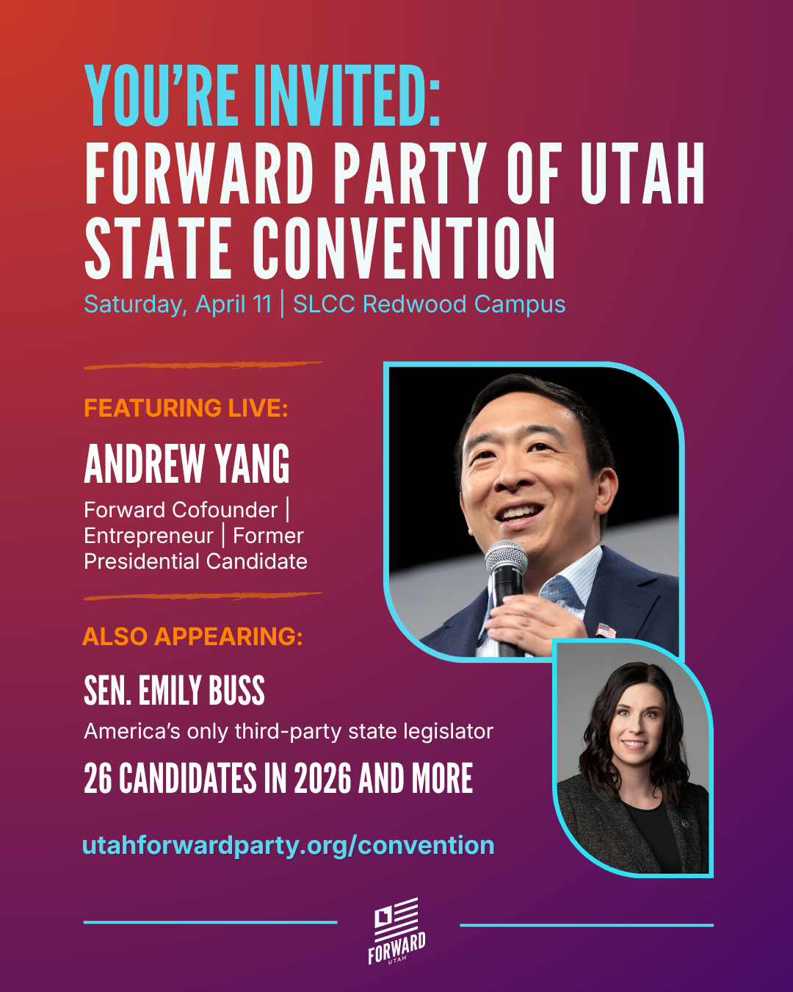
A Growing Movement
Forward Party of Utah State Convention
When: April 11, 2026 at 10:00 AM
Where: Salt Lake Community College 4600 S Redwood Rd, Taylorsville, 84123
Who is invited:
  Only Forward Party members can vote in party proceedings
  Non-voting guests are also highly encouraged to attend!
RSVP: https://www.utahforwardparty.org/state_convention_20260411

Slide 8
Forward Party: More Information
National Forward Party
  https://www.forwardparty.com/
  It’s Up to Us: A Forward Party Podcast
    https://www.forwardparty.com/podcast/
Forward Party of Utah
  https://www.utahforwardparty.org/
  Upcoming Events: https://www.utahforwardparty.org/events
Cache County Forward Party
  Email: cache@utahforwardparty.org

