Slide 1

Motivational Interviewing
Session 2: Engaging with OARS
Presented by David Christian, Ph.D.
April 7, 2026

Slide 2
Review
Session 1: MI Overview
Questions?
Have you tried some MI?

Slide 3

Review
Spirit of MI
Partnership
Four Processes
Engage
Focus
Evoke
Plan
Acceptance
Compassion
Empowerment
Way of Being

Slide 4
How to Engage Others?
Create a working alliance.
Requires genuine curiosity.
Show active interest in their experience.
Show accurate (active) empathy.
Set your agenda aside- for now.
Focus fully on their meaning.
Interview to understand.

Slide 5

To Engage: Use OARS
Open Questions
Affirmations
Reflections
Summaries

Slide 6
Session Overview
Define and Illustrate Oars
Demo: Role Play
Breakout groups- practice OARS
Group Discussion

Slide 7
Open Questions:
  Use the 6 W’s: Kindly seek to understand them
Affirmations
  Openly recognize anything positive about them.
Reflections
  Show understanding of their thoughts, actions, feelings and values (reasons).
Summaries
  Summarize to foster ongoing collaboration.

Slide 8

Open the Dialogue with Open Questions
  Closed: Do you support our proposal?
  Open: What do you know about our proposal?
  Try the 6 W’s: Who, What, When, Where, (Why), and How

Slide 9
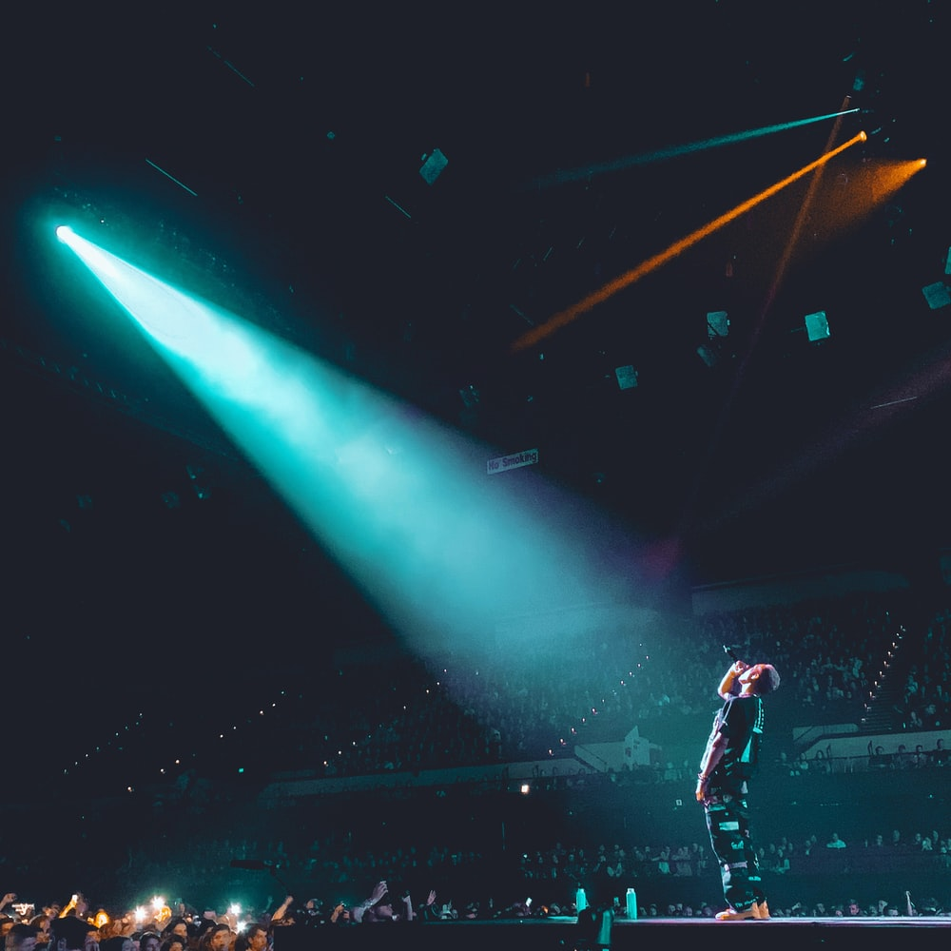
Affirm Them
Spotlight Their:
Strengths, Attributes
Efforts
Values
Intentions
Drop “I,” it’s about them.

Slide 10
Where to Get Affirmation Ideas?
Relevant accomplishments.
Their history of success in related areas.
Things you personally like/appreciate
Their passion, commitment, investment.
Their strengths, character qualities.
For lobbying: media, website, history (notes).

Slide 11
Reflectively Listen
(check your understanding)
Show nonjudgmental understanding of their:
  Thoughts
  Feelings
  Values/Reasons
  Both stated (surface) and implied (deep)

Slide 12
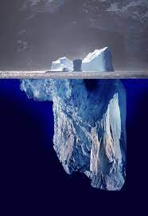
Reflections
Simple reflection shows the exposed iceberg (what they said).
Deep reflection shows the submerged iceberg (what they are implying).
Make your best guess about what the person means by “Continuing the paragraph” to encourage them to go deeper.
Reflection stops dead horse beatings.
Keep reflections brief.

Slide 13
Summaries
Interim summaries: bundle several reflections.
  “Here’s what I’ve heard so far…”
Final Summaries:
  Options discussed and agreements.
  Why this is important.
  Point the way forward (TNT)
1, 2, 3, 4?

Slide 14
Demo: Role Play
Me: MI User: Using OARS to show understanding.
Other:
Observers: Count O’s, A’s, R’s, S’s
  O ////
  A //
  R ////
  S //

Slide 15
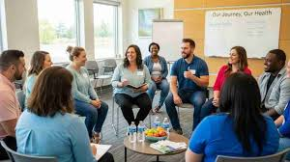
Breakout Rooms Role Play
Interviewer: Use OARS
Partner:
Observer: Count OARS, keep time
Chat 5 mins, Feedback 2 mins
Make mistakes!

Slide 16

Discuss
Interviewer: Your experience?
Partner: Your experience?
Observers- what did you notice?
Everyone-
Observations
Questions

Slide 17
What’s Next
Practice OARS
Recording link- emailed to you.
Send me role play paragraphs.
Webinar #3 Tuesday May 5, 6:00 p.m.

